Slide 1
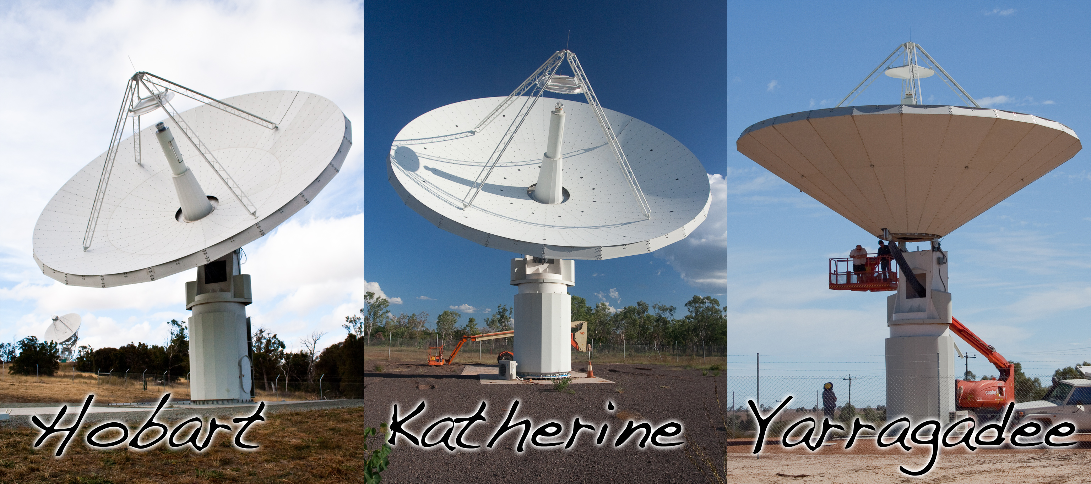
The AuScope 12m antennas

Slide 2
The AuScope 12m antennas

Slide 3
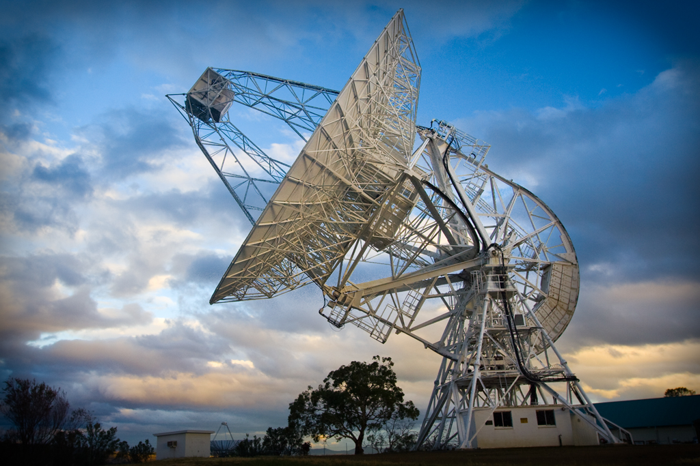
Mt Pleasant Observatory

Slide 4
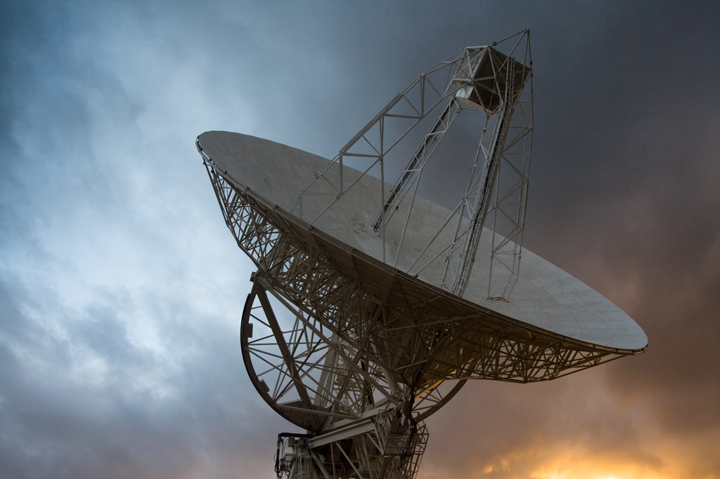
Mt Pleasant
Observatory

